Slide 1
PASSWORD WALLET
By-
M.N.M Pradeep (11K81A0583)
M.Saikrishna (11K81A0584)
Raghunandan.G (11K81A05AO)
Sania Alex (11K81A05A2)

Slide 2
ABSTRACT
Nowadays we need to remember many passwords.
Is there a method to remember all these passwords, or even better, store them all in a computerised private locker, such that no person other than the owner has access to the passwords?
Our project is that computerised private locker!!!

Slide 3
EXISTING SYSTEM
Most of the online accounts require passwords which should include letters, digits and special characters. This makes passwords more difficult to remember.
People tend to write down passwords on paper which makes it completely defenceless.
Once a password is forgotten, the user has to go through a series of steps in order to retrieve it.

Slide 4
PROPOSED SYSTEM
The proposed system is an easy-to-use safe which stores all the passwords of a user in a secure manner.
The program stores the passwords in a highly encrypted database. This database consists of only one file, so it can be transferred from one computer to another easily.
The passwords are encrypted using AES algorithm.
SHA-256 is used as password hash. SHA-256 is a 256-bit cryptographically secure one-way hash function. In contrast to many other hashing algorithms, no attacks are known yet against SHA-256.

Slide 5
HARDWARE REQUIREMENTS
Processor- Pentium-3 or later versions.
Speed- 1 Ghz or faster 32-bit or 64-bit processor.
RAM- 256 MB
Monitor- 15 VGA colour
Keyboard- 110 keys enhanced.

Slide 6
SOFTWARE REQUIREMENTS
Operating System- Windows 95/98/2000/XP/8/8.1
Front End- Java
Back End- MS Access
IDE- Notepad++

Slide 7
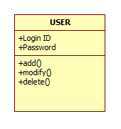
CLASS DIAGRAM

Slide 8
USECASE DIAGRAM

Slide 9
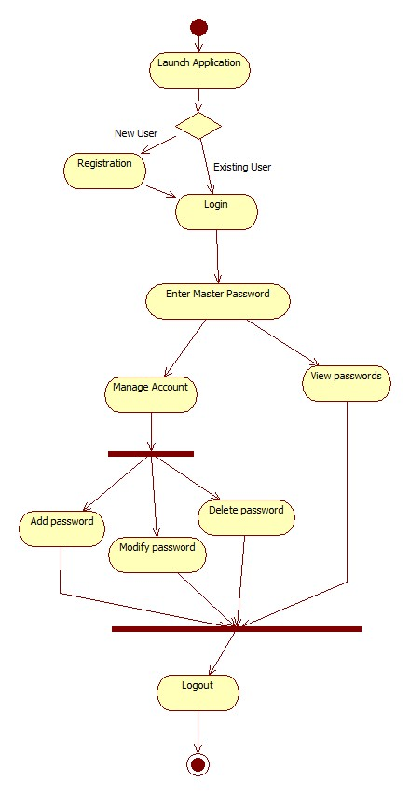
ACTIVITY DIAGRAM

Slide 10
SEQUENCE DIAGRAM

Slide 11
STATECHART DIAGRAM

Slide 12
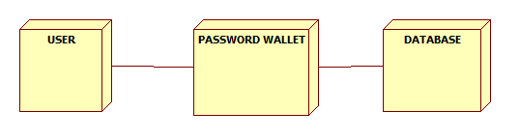
DEPLOYMENT DIAGRAM

Slide 13
SCREENSHOTS

Slide 14
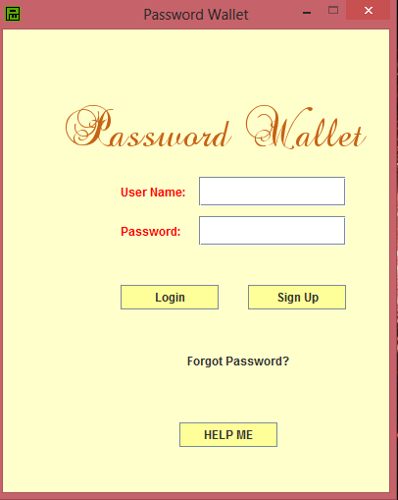
Login screen of Password Wallet

Slide 15
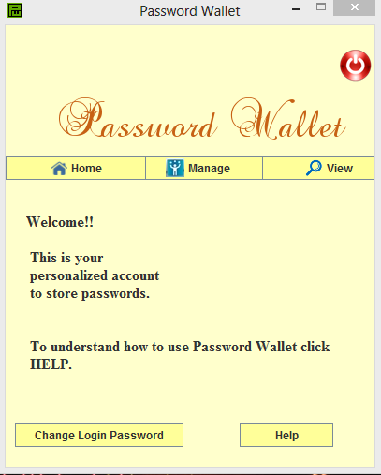
Home Screen of Password Wallet

Slide 16
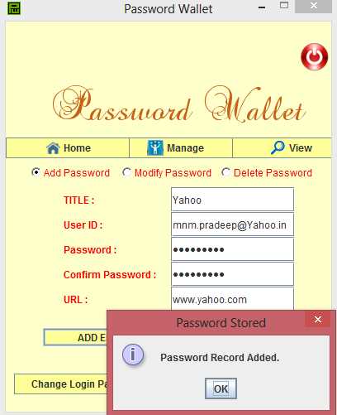
Adding passwords

Slide 17
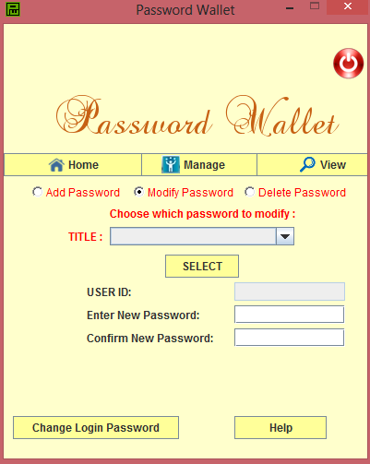
Modifying passwords

Slide 18
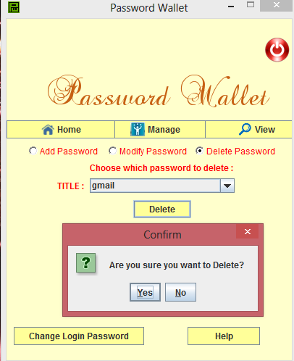
Deleting Passwords from Password Wallet

Slide 19
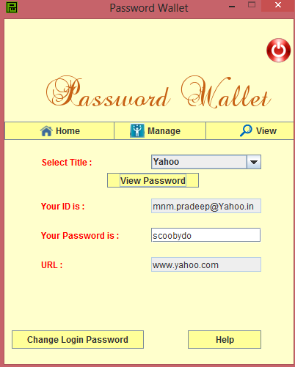
Viewing Passwords

Slide 20
CONCLUSION
Thus, this project aims at creating an application which can manage all the passwords for a user, without compromising on security. Users do not have to worry about remembering dozens of passwords as every password is locked up safely for him which can be unlocked only by a master password. The encryption/decryption and SHA algorithms used, make sure that the system remains secure against brute-force attack or any kind of security attack.

